Slide 1

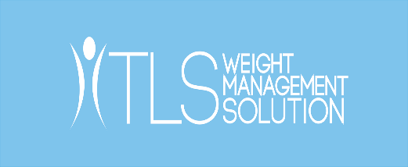
WELCOME TO TLS WEIGHT MANAGEMENT
SOLUTION

Slide 2

THE TLS 21 DAY
CHALLENGE

Slide 3
TLS 21 DAY CHALLENGE
A SIMPLE, SHORT TERM PROGRAM DESIGNED FOR EFFECTIVE WEIGHT MANAGEMENT
#TLS21DAYS

Slide 4
TLS 21 DAY CHALLENGE
WHY TAKE THE 21 DAY CHALLENGE?
Take the Challenge if you want to…
TONE UP
LOSE 2-9 KGS
OF BODY FAT*
JUMPSTART A LONG-TERM WEIGHT MANAGEMENT JOURNEY
*Individuals following the TLS Weight Management Solution as part of a healthy diet and exercise program can expect to lose 0.45-0.9 kg per week. You should consult your physician before beginning this or any other weight-management program.
#TLS21DAYS

Slide 5
TLS 21 DAY CHALLENGE
WHAT IS THE TLS 21 DAY CHALLENGE?
The TLS 21 Day Challenge is a straightforward program created for shedding excess weight healthily, but quickly.
The Challenge is broken into two phases: Phase 1 is a cleanse - a fresh start for your body that prepares it for the second step, Phase 2.
This is the fat-burning phase, where fat and centimeters are lost. This short-term program challenges customers to start living a healthy life for their own long-term benefit.
#TLS21DAYS

Slide 6

TLS 21 DAY CHALLENGE
21 DAY CHALLENGE OVERVIEW VIDEO
#TLS21DAYS

Slide 7
TLS 21 DAY CHALLENGE: PHASE 1
WHY IS DETOXING IMPORTANT?
Detoxing assists with improving your metabolism, curbing your cravings and enhancing your weight management efforts. It’s important to detox because overeating, consuming unhealthy foods and sugary drinks burdens your digestive tract and liver.
Overtime this can lead to poor digestion and the inadequate absorption of nutrients. This causes you to feel hungry, tired and bloated — forcing your body to stay in fat storage mode.
Your digestive tract and liver work together, so when one is stressed or overworked the other is too. One of the consequences of having an overstressed or toxic liver is that it becomes so overloaded that it can’t fully metabolise fat, which causes vitamin deficiencies and poor digestion.
#TLS21DAYS

Slide 8
TLS 21 DAY CHALLENGE: PHASE 2
WHY ARE THESE RIGOROUS WEEKS IMPORTANT?
In order to achieve fast results a high intensity Phase is required. Following Phase 2 correctly is vital — you can lose up to 4.5 kilograms if you stick to the regimen! During these weeks you’ll note an emphasis on exercise.
With this strict Phase you will feel better, both physically and emotionally. For overall cardiovascular health, Fitness Australia recommends at least 150 minutes of moderate intensity cardiovascular exercise or 75 minutes of vigorous cardiovascular exercise per week.†
Consuming enough fibre and protein during Phase 2 is also important, because fibre and protein at every meal makes managing weight simple! The TLS Nutrition Shakes supply 18 grams of protein and 10 grams of fibre to help you achieve your nutritional needs, and support your weight management efforts.
        †
          †SOURCE: http://www.heartfoundation.org.au/SiteCollectionDocuments/physical-activityin-patients-with-cvd-management-algorithm.pdf
          http://www.getmoving.tas.gov.au/data/assetsfile/0003/45048Fitness_Australia_cardiovascular_exercise_prescription_for_healthy_adults1.pdf
#TLS21DAYS

Slide 9
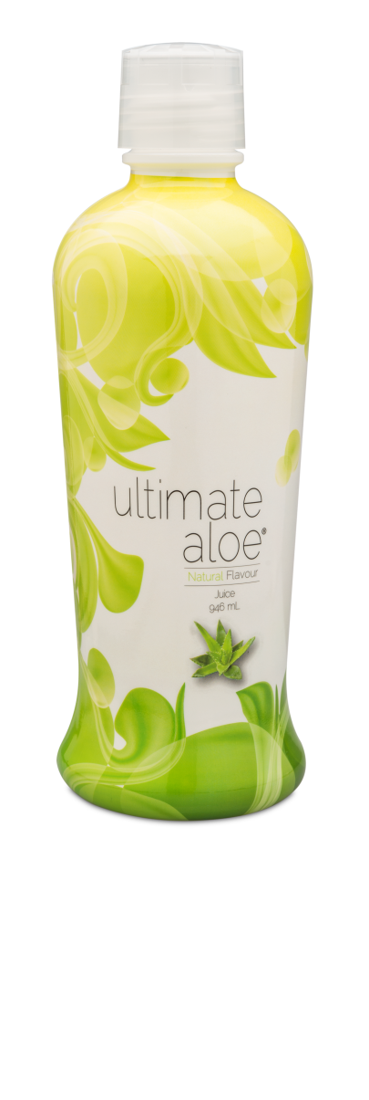
TLS 21 DAY CHALLENGE: PHASE 1
WHY ARE THE RECOMMENDED SUPPLEMENTS BENEFICIAL?
Ultimate Aloe Juice:
This great tasting supplement is a source of over 200 nutrients, enzymes, vitamins and minerals, including 13 of the 17 essential minerals needed for good nutrition.
#TLS21DAYS

Slide 10
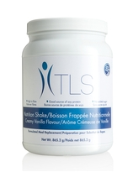
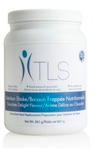
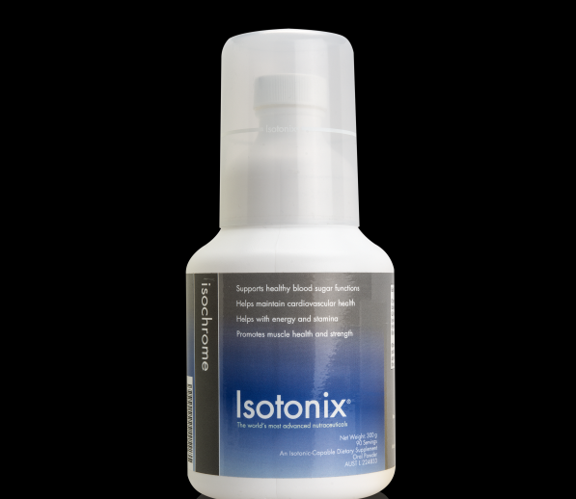
Note: Isochrome serving size and bottle may have changed.*
TLS 21 DAY CHALLENGE: PHASE 2
WHY ARE THE RECOMMENDED SUPPLEMENTS BENEFICIAL?
Isotonix Isochrome*:
This distinctive combination of essential compounds provides nutrients that can help to support healthy blood sugar maintenance, energy and improve the success of most weight-management programs.
TLS Nutrition Shakes:
These delicious chocolate and vanilla shakes are formulated to deliver an optimal balance of protein, carbohydrates and fats in every serving. TLS Nutrition Shakes are perfect for anyone who finds it difficult to get the recommended daily amount of fibre and protein.
#TLS21DAYS

Slide 11
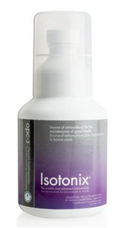
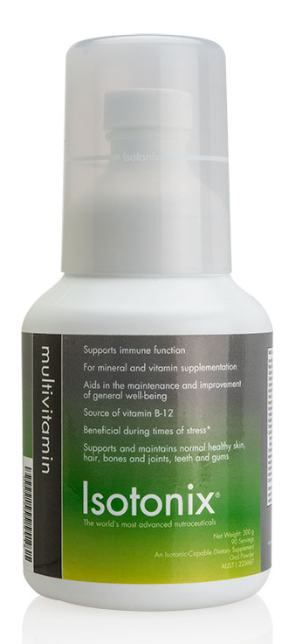
TLS 21 DAY CHALLENGE: PHASE 1& 2
WHY ARE THE RECOMMENDED SUPPLEMENTS BENEFICIAL?
Isotonix OPC-3:
This powerful antioxidant with Pycnogenol® helps fight oxidation and free radicals in the body.
Isotonix Multivitamin:
It delivers 100 percent or more of the daily value of many essential vitamins and minerals. It also contains vitamins that support the body’s ability to help with metabolism and conversion of food into energy.
#TLS21DAYS

Slide 12
TLS 21 DAY CHALLENGE
21 DAY CHALLENGE SUPPORT
TLS 21 Day Challenge Guide
Coaches Training Guide
Videos
Infographics
Tracking Sheet
Recommended Supplements
FAQs
#TLS21DAYS

Slide 13
TLS 21 DAY CHALLENGE
WHO CAN SELL THE 21 DAY CHALLENGE?
ANY UNFRANCHISE
OWNER CAN SELL THE CHALLENGE!
PREVIOUS KNOWLEDGE OF TLS IS NOT REQUIRED
WHETHER YOU’RE A NEW MARKET AUSTRALIA UFO OR A TLS EXPERT —YOU’RE ALL QUALIFIED!
#TLS21DAYS

Slide 14
TLS 21 DAY CHALLENGE
HOW DO I SELL THE 21 DAY CHALLENGE?
Selling the TLS 21 Day Challenge is as clear-cut as the Challenge itself. After selling the kits you can let customers do the Challenge on their own! Alternatively, you can set up a Challenge group with multiple customers starting together, or you can simply follow up with your customers throughout their Challenge. You may decide to take the Challenge yourself, take it with your customers, or choose to simply sell the challenge kits without partaking— it’s really up to you!
#TLS21DAYS

Slide 15
TLS 21 DAY CHALLENGE
HOW DO I SELL THE 21 DAY CHALLENGE?
GET CUSTOMERS TO COMMIT TO GET FIT IN JUST 21 DAYS
1
2
3
4
5
PURCHASE
TLS 21 DAY CHALLENGE KITS FOR YOUR INVENTORY ON SHOP.COM.AU
PROMOTE
ON SOCIAL MEDIA WITH OUR VIDEOS, IMAGES AND BLOG POSTS
SECURE CUSTOMERS AND ASK FOR THE ORDER
SELL
THE TLS 21 DAY CHALLENGE KITS
SHARE
YOUR CUSTOMERS’ SUCCESSES WITH US
#TLS21DAYS

Slide 16

#TLS21DAYS

Slide 17

BE SOCIAL, BE CONNECTED
SHARE TLS

Slide 18
TLS 21 DAY CHALLENGE
WHY SHOULD YOU SELL THE 21 DAY CHALLENGE?
Easy to Sell & Explain
Substantial Profit Margin
Boost Your Business
Short Term Commitment
Grow Your Customer Base
Cost-effective
#TLS21DAYS

Slide 19
TLS 21 DAY CHALLENGE
WHY SHOULD YOU SELL THE 21 DAY CHALLENGE?
The Challenge is easy to sell and explain, because in-depth knowledge of TLS is not required. There are also support materials available to promote the Challenge and consequently, your business.
The Challenge is intended for everyone, but it is especially aimed at a market who prefers short-term programs with rapid results. This means you can boost your business quickly; resulting in more sales and new customers.
Since the Challenge is cost-effective for your customers, it enables you to sell additional products to them, which will further support their goals.
Lastly, your profit margin per kit is substantial. And you’ll have repeat customers — getting big results quickly equals devoted customers for life who believe in the products.
#TLS21DAYS

Slide 20

REAL PEOPLE, REAL
STORIES

Slide 21
TLS 21 DAY CHALLENGE
CHECK OUT SOME OF THE
21 DAY CHALLENGE SUCCESS STORIES!*
      *Individuals following the TLS Weight Management Solution as part of a healthy diet and exercise program can expect to lose 0.45-0.9kg per week. The persons sharing their stories are UnFranchise® Owners of Market America products. You should consult your physician before beginning this or any other weight-management program.
#FINDYOURFIT

Slide 22

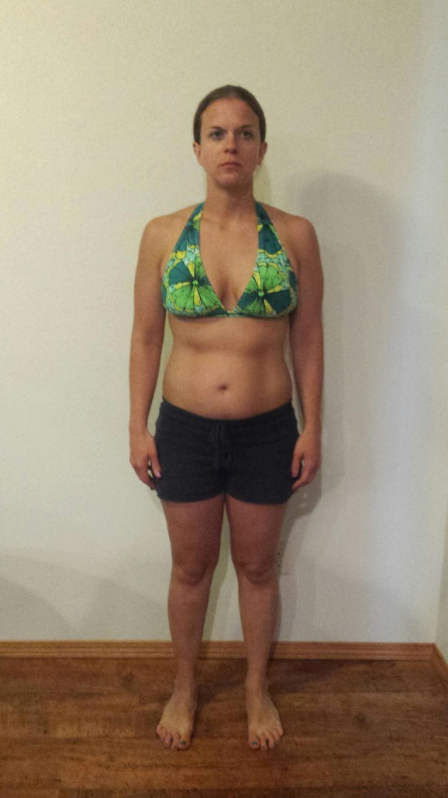
GINA H.
TLS 21 DAY CHALLENGE
21 DAYS
#FINDYOURFIT

Slide 23
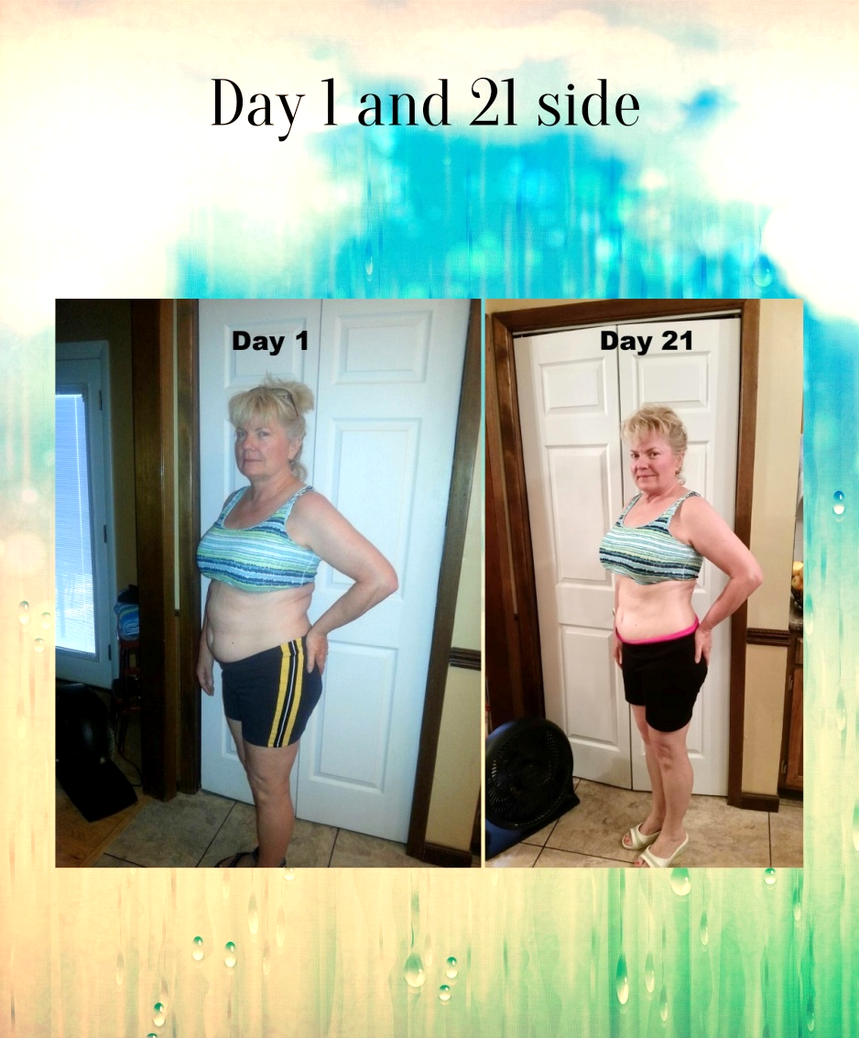
HEATHER R.
TLS 21 DAY CHALLENGE
21 DAYS
#FINDYOURFIT

Slide 24
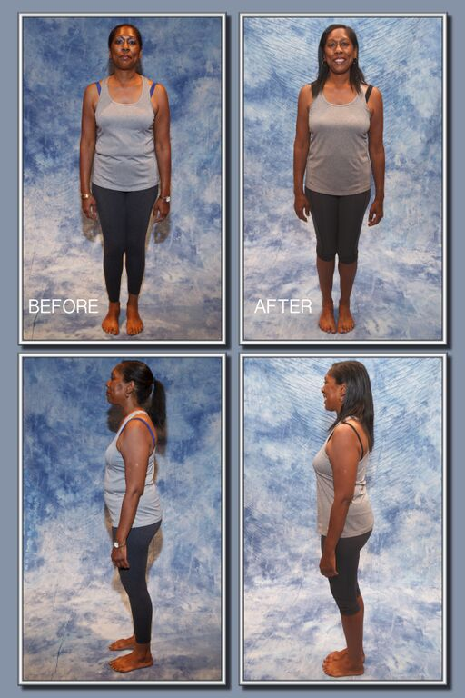
KATHLEEN C.
TLS 21 DAY CHALLENGE
21 DAYS
#FINDYOURFIT

Slide 25
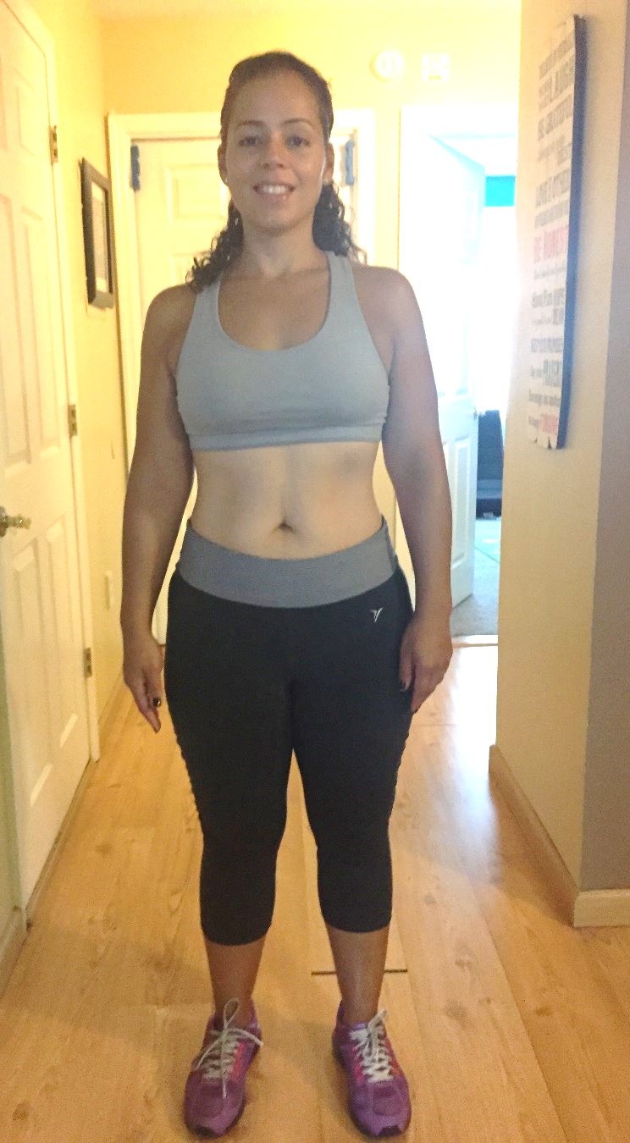

ANGELA M.
TLS 21 DAY CHALLENGE
21 DAYS
#FINDYOURFIT

Slide 26
TLS 21 DAY CHALLENGE
WHAT HAPPENS AFTER 21 DAYS?
If customers want to continue their weight management journeys we recommend that they take our FREE Weight Management Profile on tlsSlim.com.au This will determine the best long term weight management solution for them.
If they’ve reached their goal, ask them to consider becoming a Certified TLS Coach. Being a part of the weight management industry and helping others reach their goals is a great way to stay on track.
#TLS21DAYS

Slide 27
TLS 21 DAY CHALLENGE
CREATING BUSINESS PARTNERS WITH THE 21 DAY CHALLENGE
When a customer loses weight through the TLS 21 Day Challenge, they will recommend the program to their friends and family.
Ask customers “Have you ever considered helping people lose weight with the TLS 21 Day Challenge and becoming a TLS Coach?”
This is your first step to prospecting a new partner.
THE TLS 21 DAY CHALLENGE IS A GREAT WAY TO BUILD CUSTOMER SHARE AND BUSINESS PARTNERS
#TLS21DAYS

Slide 28

#FINDYOURFIT

Slide 29

TLS WEIGHT MANAGEMENT SOLUTION
#FINDYOURFIT
THE HEALTHIEST SOCIAL MEDIA AND
LIFESTYLE CLUB ON THE PLANET

